Slide 1
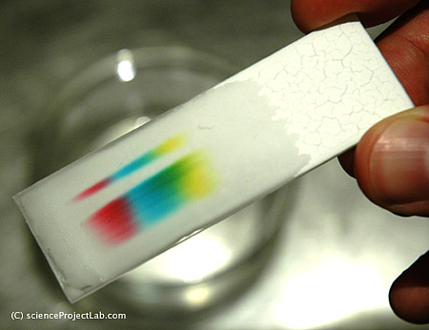
Chromatography
7F Reactions with oxygen – What is burning?
Unit 1
Lesson 6

Slide 2
Today’s Aim
7F Reactions with oxygen – What is burning?
Unit 1
Lesson 6
By the end of this lesson I will be able to describe the technique of chromatography and understand how to interpret a chromatogram

Slide 3
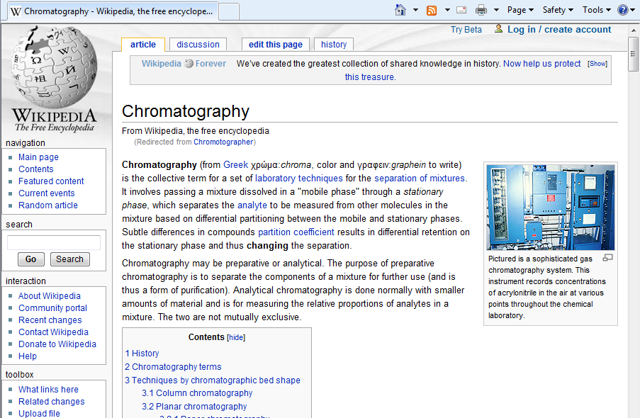
Chromatography from Wikipedia

Slide 4
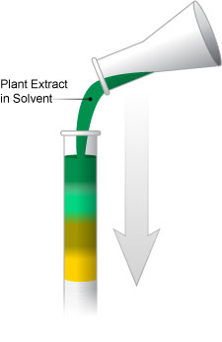
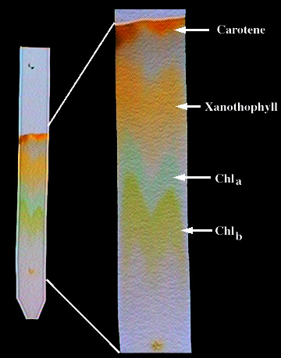
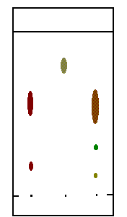
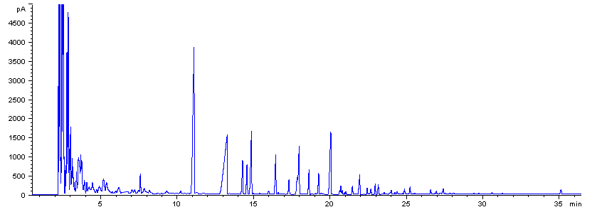
Examples of chromatography
Liquid Chromatography
Used to identify unknown plant pigments & other compounds.
Thin-Layer Chromatography
Uses thin plastic or glass trays to identify the composition of pigments, chemicals, and other unknown substances.
Gas Chromatography
Used to determine the chemical composition of unknown substances, such as the different compounds in gasoline shown by each separate peak in the graph below.
The one you need to know →
Paper Chromatography
Can be used to separate the components of inks, dyes, plant compounds (chlorophyll), make-up, and many other substances

Slide 5

Separation Techniques
Filtration:
to separate an insoluble substance from a solution
Crystallisation:
to separate a soluble substance from a solution
Paper Chromatography:
to separate a mixture of soluble dyes or pigments.

Slide 6
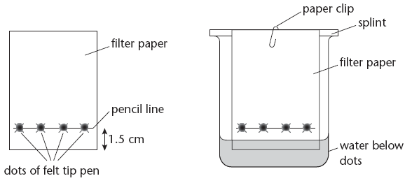
Chromatography

Slide 7
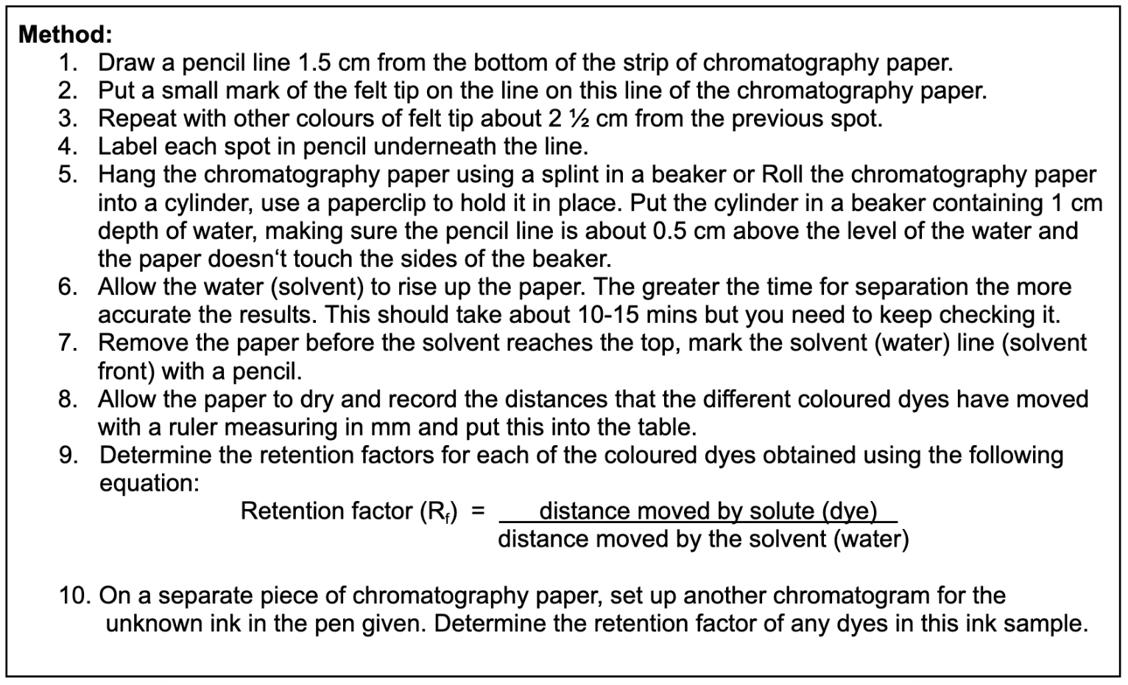
Method - page 21

Slide 8
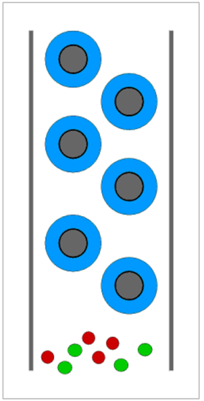
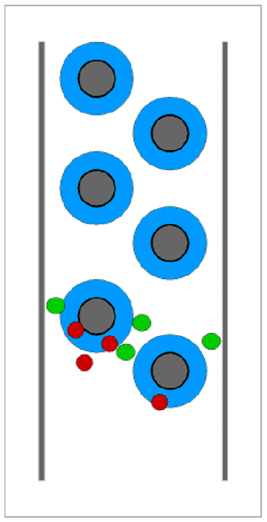
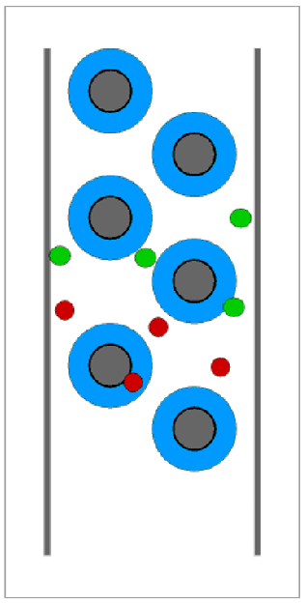
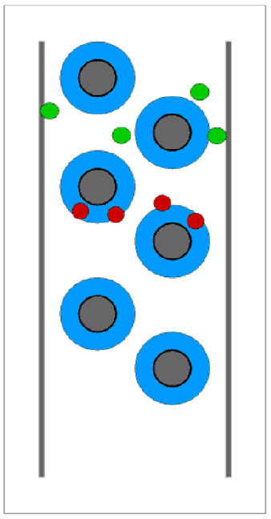
How does it work?
Chromatography paper
Mixture of dyes
In this model the green dye is more soluble in the solvent than the red dye is.

Slide 9
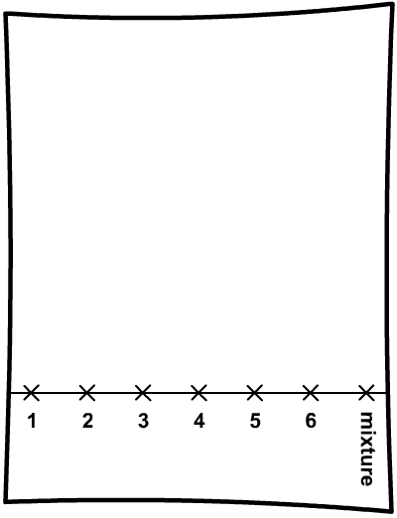
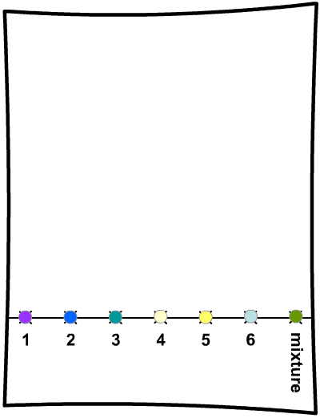

Paper chromatography
This chromatogram shows the pattern made by six different pure dyes, 1-6.
The mixture contains 2 of these dyes – which ones?

Slide 10
Chromatography
What dyes are in the mixture?
1 2 3 4 5 6 Mix
1 2 3 4 5 6 Mix
→
The mixture is made up of dyes 3 and 4.

Slide 11
Chromatography
R G B X
1 2 3 Z
1) Ink X contains two different colours. What are they?
2) Which ink is ink Z made out of?

Slide 12
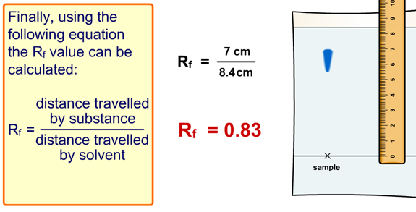
Calculating R_{f} values
The following equation can be used to calculate R_{f} values:

Slide 13
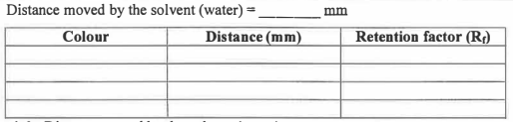
Results - page 21
Choose 2 or 3 different colours from your experiment

Slide 14
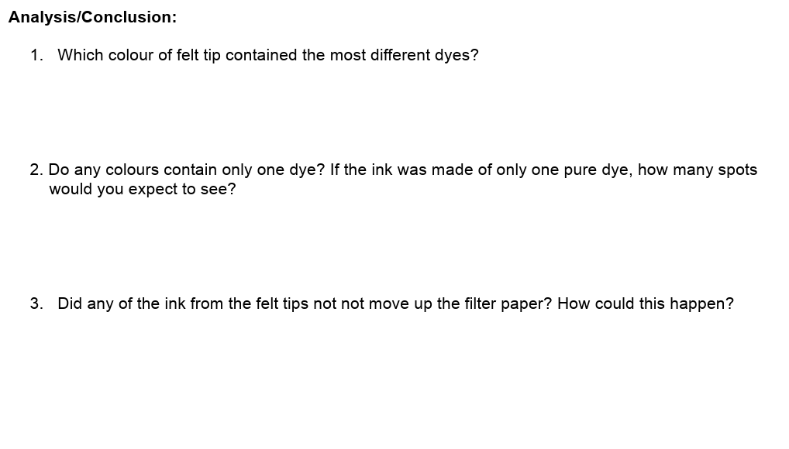
Analysis - page 22
(Depends on your experiment)
If there is only one dye in the pen, there will only be one dot of ink.
This suggests it is a pure substance (not a mixture).
This would happen if the ink is insoluble in the solvent (water) used

Slide 15
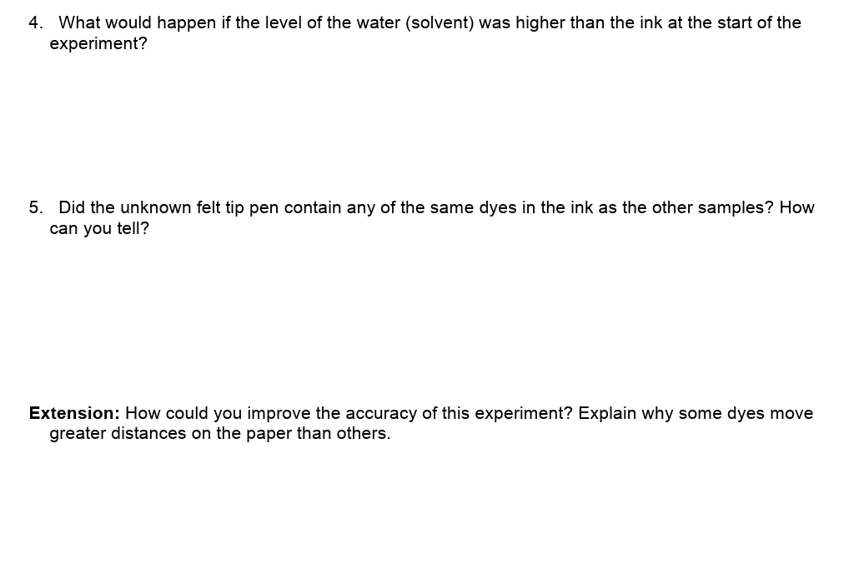
Analysis - page 22
The dye would dissolve in the water instead if going up the paper.
If the unknown pen contains any of the same dyes, the colour will rise up to exactly the same height as the other colours.
Using longer chromatography paper, and leaving the solvent to travel up for more time would lead to more accurate results.
More soluble dyes move further up the paper.

Slide 16
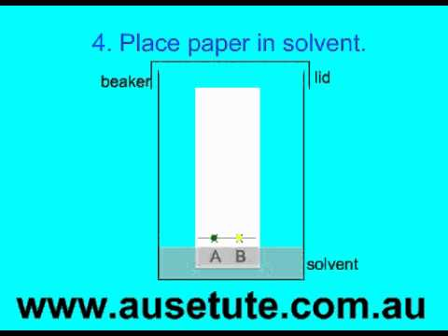
A video to watch at home

Slide 17
Plenary: order of chromatography
Allow solvent to rise up the paper and dissolve the sample and to spread out the parts of the mixture on the chromatography paper.
Draw a line in pencil, called the base line, on chromatography paper (should be pencil as carbon does not dissolve in any solvent).
Place chromatography paper in suitable solvent. The solvent should not touch the sample on the paper.
Remove chromatography paper from beaker and allow all the solvent to evaporate so it becomes dry
Place a small drop of the sample on base line on chromatography paper.
Interpret the chromatogram by calculating the R_{f} value of the different dyes.

Slide 18
What you need to know
Unit 1
Lesson 6
Syllabus Content
1.10 describe these experimental techniques for the separation of mixtures:
• paper chromatography.
1.11 understand how a chromatogram provides information about the composition of a mixture.
1.12 understand how to use the calculation of R_{f} values to identify the components of a mixture.
1.13 PRACTICAL investigate paper chromatography using inks/food colourings.
My Learning

Slide 19
Homework
Google image search “atomic structure” or “the atom”
Copy the best picture you can find and insert it into a document. (You must do some research the find the ONE best image.)
On the same page, write a paragraph about why the image you have chosen is so good. (You must be prepared to argue next lesson about why your image is better than anybody else's.)
Print your work and bring it to the next lesson.

